Slide 1
Software Engineering
Week 01 Lecture 02

Slide 2
Software Development Life Cycle (SDLC)
It is a structured process used by software developers to design, develop, test, and maintain software applications.
The SDLC is typically broken down into several phases, including planning, analysis, design, implementation, testing, and maintenance

Slide 3
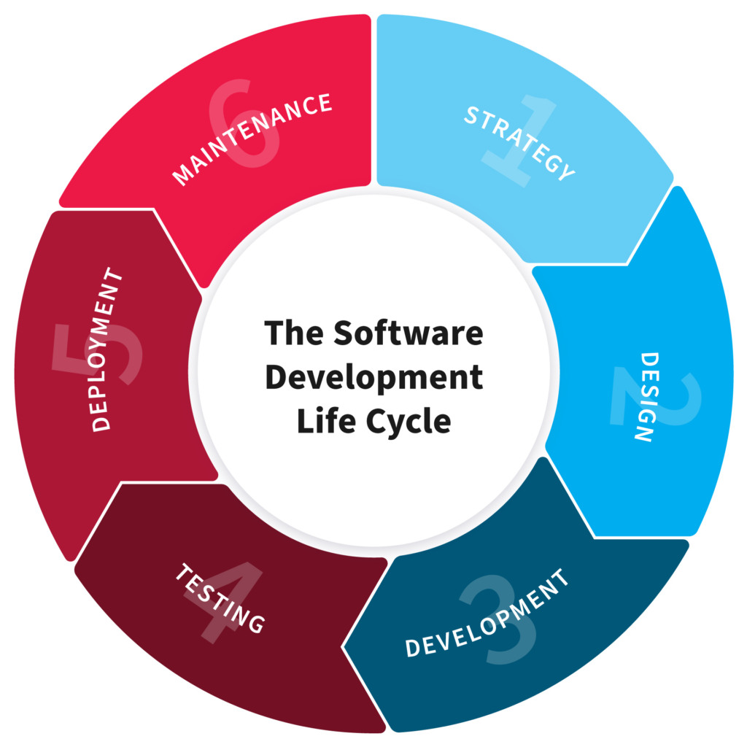
Software Development Life Cycle (SDLC)
Notes:
These phases are used to
-satisfy user/customer’s requirements
-cost effective
Within timeframe

Slide 4
PLANNING/ STRATEGY
Cost
Time
Work Division
Resources/ skills
Notes:
Done by senior members of team
quality assurance requirements and identification of the risks associated with the project is also done in the planning stage.
Doable or not

Slide 5
ANALYSIS
Sharing with team
Estimate cost
Line of code
Time
SRS(Software Requirement Specification)
Notes:
clearly define and document the product requirements and get them approved from the customer

Slide 6
DESIGN
Modules
Diagrams
Front-end
Notes:
clearly defines all the architectural modules of the product along with its communication and data flow representation with the external and third-party modules (if any).
Blueprint

Slide 7
IMPLEMENTATION
Platform
Technology
Language
Coding guidelines
Notes:
actual development starts and the product is built coding guidelines defined by their organization and programming tools like compilers, interpreters, debuggers, etc.

Slide 8
TESTING
Unit Testing / System Testing
Alpha Testing / Beta Testing
White Box / Black Box Testing
Notes:
product defects are reported, tracked, fixed and retested, until the product reaches the quality standards defined in the SRS.

Slide 9
DEPLOYMENT/ MAINTANENCE
Technical Support
Timeframe for changes
Help for users
Notes:
released formally in the appropriate market.
Maybe limited segments at first
Then based on the feedback, the product may be released as it is or with suggested enhancements

Slide 10
SDLC Models
Waterfall Model
Prototype Model
Iterative Model
Spiral Model
V-Model
Agile Model

Slide 11
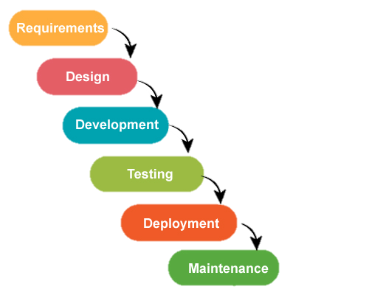
Waterfall Model
Old Model
For small projects
Notes:
Feasibility study/ requirements:
Platform
Team
Cost
skill

Slide 12
Advantages of Waterfall Model
Basic Model
Small Projects
Simple and easy

Slide 13
Disadvantages of Waterfall Model
No feedback
No experiments
No parallelism
High Risk
Maximum efforts in maintenance

Slide 14
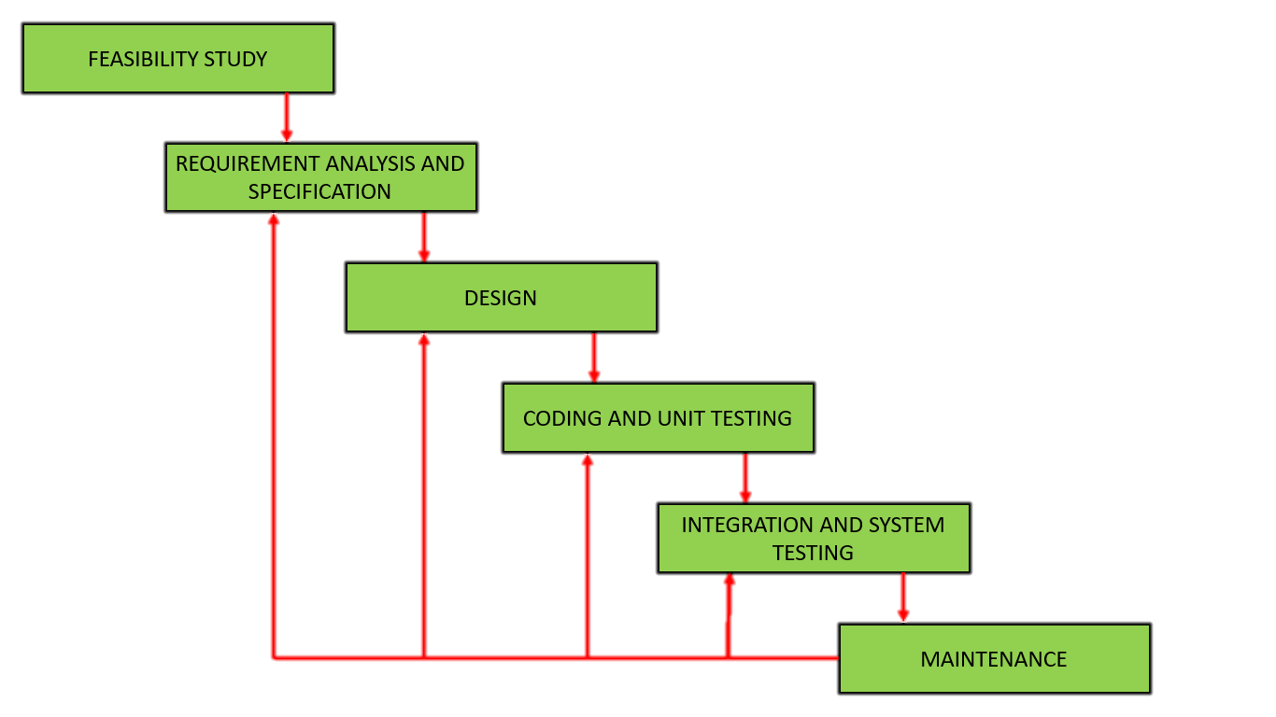
Iterative Model
Modified version of iterative model
Feedback Introduced
But no feedback in requirements
Notes:
Feasibility study/ requirements:
Platform
Team
Cost
skill

Slide 15
Advantages of Iterative Model
Basic Model
Small Projects
Simple and easy
Feedback

Slide 16
Disadvantages of Iterative Model
No parallelism
No intermediate delivery
Rigid (No changes)
Less customer interaction

Slide 17
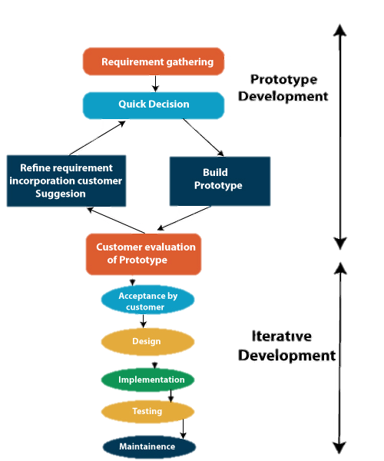
Prototype Model
Combination of Iterative and Prototyping
Good for less clarity of customer
Increase in cost of development
Notes:
Good for technical and requirement risks

Slide 18
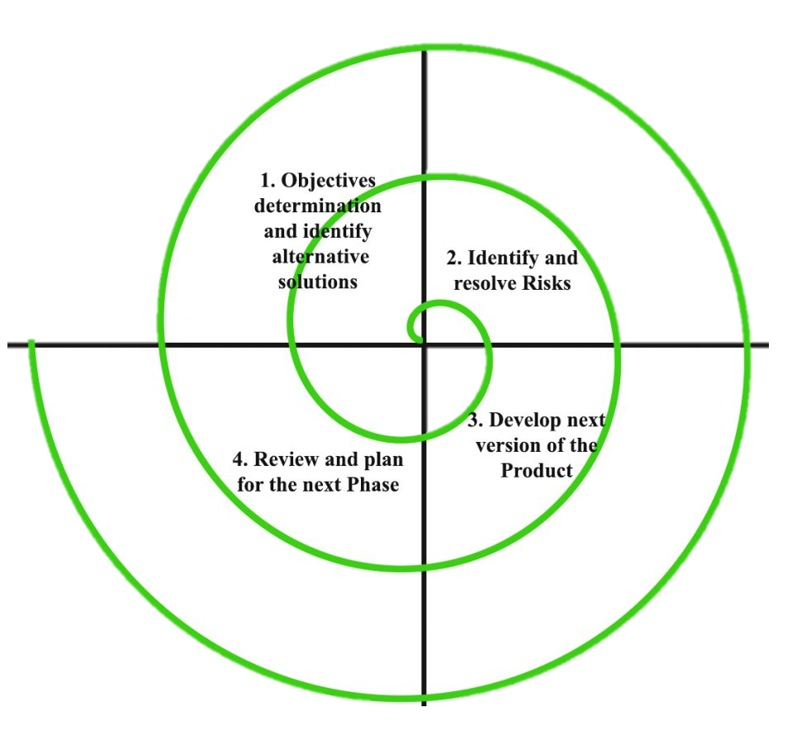
Spiral Model
Risk Handler
Radius of spiral = cost
Angular dimension = progress
Meta model
Notes:
Meta model = combo of
Waterfall– step by step
Iterative – feedback
-prototype

Slide 19
Advantages of Spiral Model
Major Risk Handling
Large Projects
Flexible
Customer satisfaction

Slide 20
Disadvantages of Spiral Model
Complex
Expensive
Too much risk analysis
Time

Slide 21
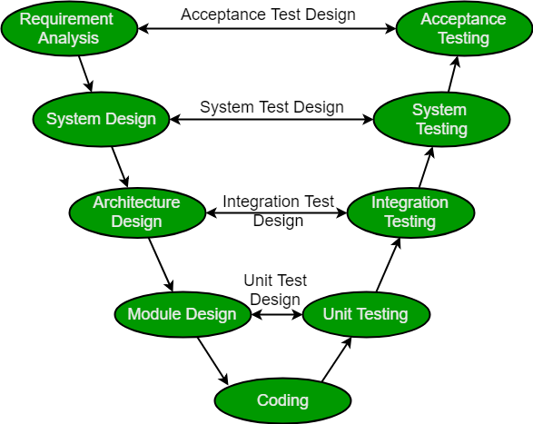
V Model
Verification and Validation
Testing at every phase
Validation
Verification

Slide 22
Advantages of V Model
Time Saving
Good understanding of project at start
Every component is tested
Progress tracking
Defect tracking
Notes:
Proactive defect tracking -- parallel

Slide 23
Disadvantages of V Model
No feedback
Risk Analysis
Not good for big projects

Slide 24
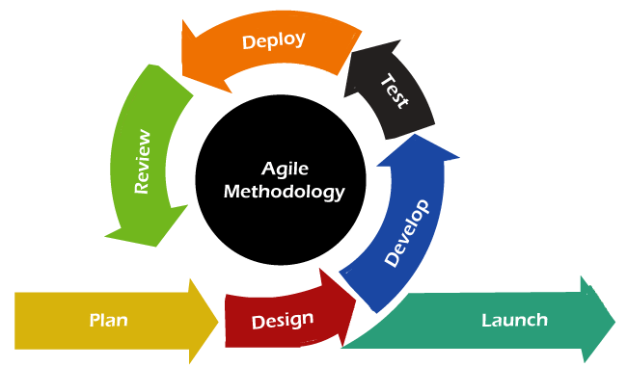
Agile Model
Fast movement
Latest
Largely used now a days
Project is divided in small modules
Modules are released and updated
Notes:
Fb, amazon, google
Small chunks-→ Release-→ Feedback → Enhance → Re-release

Slide 25
Advantages of Agile Model
Frequent delivery
Face too face communication with client
Changes are incorporated fast
Time effective
Notes:
Proactive defect tracking -- parallel

Slide 26
Disadvantages of Agile Model
Less documentation
Maintenance problem
Notes:
Proactive defect tracking -- parallel

Slide 27
WHAT HAVE YOU LEARNT IN THIS CLASS
SDLC
Waterfall Model
Iterative Model
Prototype Model
Spiral Model
V-Model
Agile Model

